Slide 1
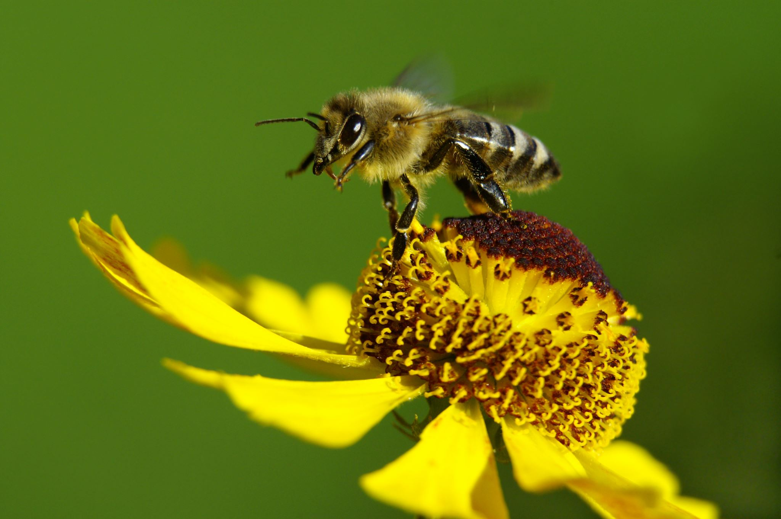








Literacy:
My Shadow is Pink
Outcomes: Innovated spoken rhymes, questions, notes of advice, lists, instructions
Main outcome: Leaflet
So Much – Trish Cooke
Outcomes: Past tense sentences, writing in role, performance/ narrative poetry
Main outcome: Own ‘So Much’ narrative poem
The Night Pirates – Pete Harris
Outcomes: Writing in role, letters, labels and captions
Main outcome: ‘How to be a pirate’ guide
Tango Makes Three – Justin Richardson
Outcomes: Signs and lists, writing in role, letters of advice, ‘new baby’ cards
Main outcome: Alternative version narrative
Hairy Maclary – Lynley Dodd
Outcomes: Character description, writing in role, letters, leaflet
Main outcome: Alternative version narrative
Oi Frog! – Jim Field
Outcomes: Rhyming flip-books, questions, captions and labels
Main outcome: Own version rhyming narrative
Fir Class – Summer 26
Topic – Gardens
Understanding of the World:
Growing and minibeasts - Children will understand important changes and processes in the natural world by exploring the natural world around them using materials, tools and techniques, experimenting with colour, design, texture, form and function. They will identify the various stages of the life cycle of a caterpillar/butterfly? Be able to identify minibeast habitats and why they live there?
Children will learn about different plants and what they need to grow by growing salad. Children will plan, prepare and make a salad.
Seasons – We will continue to develop our understanding of the change of seasons and how these changes can be seen within the school environment.
PSED
Being my Best
Bouncing back when things
go wrong
Yes, I can!
Healthy eating
My healthy mind
Move your body
A good night's sleep
Growing and changing
Life Stages: Human life stage
- who will I be?
Where do babies come from?
Getting bigger
Me and my body - girls and boys
RE:
Which places are special and why?
During this unit we will be taking a trip to St Thomas’ Church in Hanwood. Children will be learning about the special buildings of other religions.
Which stories are special and why?
The children will be learning about the sacred texts of major world religions and being taught about an important story from each text.
Expressive Art and Design:
Music
Bird Spotting: Cuckoo Polka –Children will explore their voices by imitating the sounds of birds. Play a simple singing game based on the two-note ‘cuckoo call’.
Five Fine Bumble Bees - children will learn to sing the song in call-and-response, and there are opportunities for adding percussion and creating minibeast soundscapes
Children will be exploring the art of ‘Georgia O’Keefe’ using the text ‘Through Georgia’s Eyes’ by Rachel Victoria Rodriguez as a starting point to experiment with colour and different art techniques. We will the surrounding environment to take inspiration when creating original artwork.
Physical Development
This term, our external coach will be teaching the children a range of different team games. We will continue to have separate lessons for Nursery and Reception. This lesson will be on a Thursday. We ask that children in Reception come into school in their PE kits and if your child attends Nursery on this day please ensure that your child is wearing clothes and shoes suitable for being outside.
We will continue to have outdoor learning on a Tuesday. If possible, please provide your child with a pair of wellies and if you have one a puddle suit (hopefully we won’t need them!) During the day children will have many opportunities to practise and develop fine motor skills including; handwriting and mark making
Numeracy:
Subitising - knowing straightaway without needing to count a small group of objects
Counting
Cardinality (the last number in the count tells us ‘how many’ things)
Ordinality - the order of events, total or numerals
Composition – How a total can be made up of different values
Comparison – Comparing the value of two groups
Mass and capacity
Length, height and time
Exploring 3D shapes
Homework
Parents are encouraged to read with their child at home.
Pupils will be given a reading book which matches the phonics they are learning in class.
Flashcards of sounds to practice will come home along with some key words to practice reading and spelling. We ask that reading books are brought into school everyday.
We also strongly encourage you to actively contribute to your child’s Seesaw journal as it is a super way to see what your child is doing in school, contribute to topics and celebrate success at home.

