Slide 1
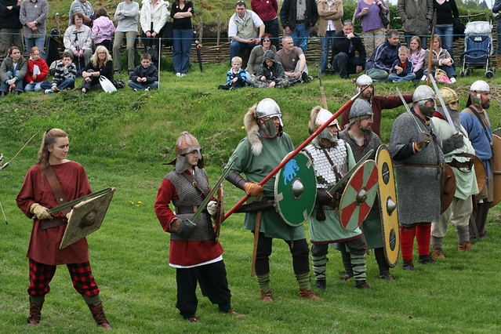
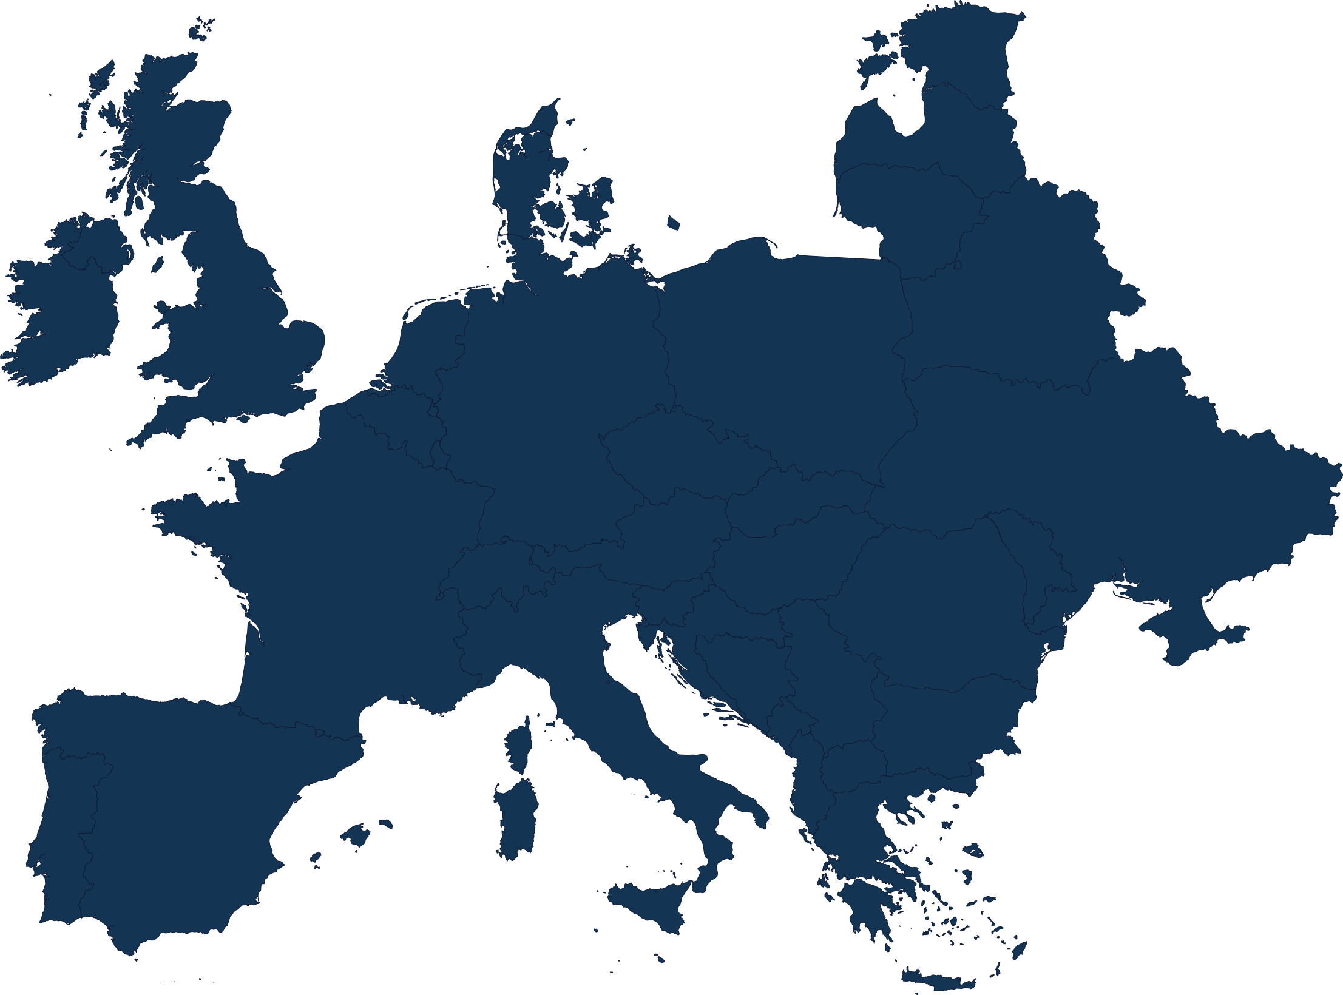
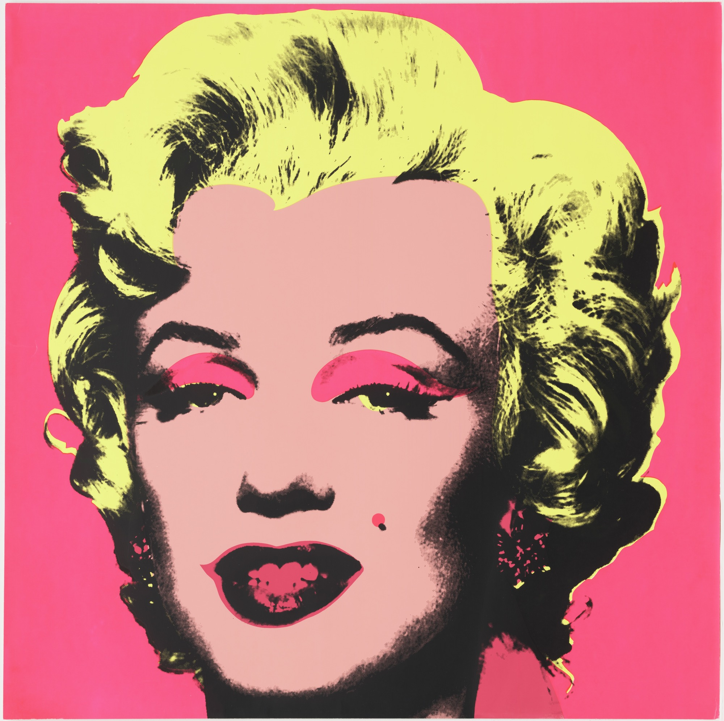
Oak Class
Summer Term 2022
Science
Electricity
Understanding circuits and their
role in electrical applications.
Consolidations and investigations
Consolidating and revising Scientific concepts and working scientifically by formulating and investigating Scientific questions.
PSHE
Being My Best: Identify my own skills and talents, practise wellbeing, analyse the risk of situations and learn some basic first aid skills.
Respect Yourself & Relationships and Sex Education
History
Anglo-Saxons: Exploring the kingdoms and conquests of the Anglo-Saxons, as well as their pastimes, beliefs and burials.
Geography
Europe: Identifying the location, diversity, rivers and mountains and analysing the population.
Deciduous forest biome: Identifying the location, physical features, human processes and diversity of this biome.
As readers, our children will use the following texts to support and enhance their learning:
Fiction: ‘Twitch’ by M. G. Leonard, ‘Letters from the Lighthouse’ by Emma Carroll, ‘Thief in the Village’ by James Berry and 'Aladdin and the Genies' by Vivian French.
Non-Fiction: ‘Our Queen Elizabeth: Her Extraordinary Life from the Crown to the Corgis’ by Kate Williams & Helen Shoesmith.
Poetry: ‘I am Cat’ by Jackie Morris.
Maths
Statistics: Read and interpret tables in order to use the data when drawing and solving problems with line graphs and pie charts. Find the mean, sum and difference of the data.
Measurement – Volume: Compare the volume of different shapes. Estimate the volume of cuboids (including cubes) using blocks, and capacity, using water.
Geometry – properties of shapes: Draw, estimate, compare and measure acute, obtuse and reflex angles and measure and recall the angles of triangles, quadrilaterals, regular and irregular polygons.
Geometry – position and direction: Recognise, describe and build 3D shapes, including making nets. Describe the position of different shapes using coordinates in all four quadrants of a grid. Translate and reflect shapes.
Consolidation: Practise and investigate questions and topics to consolidate our maths knowledge. Y6 will have a range of questions to answer from their chosen Secondary School as part of their transition activities.
Languages:
Read, write, speak and understand numbers up to 50, prepositions, days, colours and leisure .
RE:
Christianity: What would Jesus do?
Thematic/Non-religious views: What matters most to Humanists and Christians?
Key events:
Reading The Game
SATs for Y6
Queens Platinum Jubilee Celebrations
Young Carers Assembly
Mary Webb Induction Days for Y6
Mary Webb STEAM Day for Y5
Bikeability
Sports Day
KS2 Summer Performance
Leavers Service and Assembly for Y6
PE and Sport
Reading The Game: Football & PE skills with a Shrewsbury Town Football Club coach
Net and wall games
Athletics
Our children will use the texts and the links to the curriculum to develop their skills as writers of:
Narrative texts – Describing settings, characters and atmosphere and integrating dialogue to convey character and advance the action.
Poetry and Play-Scripts – Preparing poems and plays to read aloud and to perform, showing understanding through intonation, tone and volume so that the meaning is clear to an audience.
Non-fiction texts – Retrieve, record and present information from non-fiction.
Grammar, Punctuation and Spelling – Consolidation of key grammar and punctuation, spellings. In our English topics we will focus on, expanded noun phrases, inverted commas, sentence structure, hyphens and commas.
Music
Exploring musical processes: Exploring sound tracks, musical cartoons and music from the movies.
Performing together: Understanding that music is created to be performed and performing tracks together.
Summer Performance
Art and Design
Printing: Pop Art
Explore the artwork of Andy
Warhol and take inspiration from his work to master the techniques and develop my own Pop art piece.
Design Technology
Frame Structures
Design, make, evaluate and improve a framed structure that fits a design brief.
Computing
Modelling – Planning, developing and evaluating 3D computer models of physical objects.
Computing Sensing– Designing and coding a project that captures inputs from a physical device.

