Slide 1
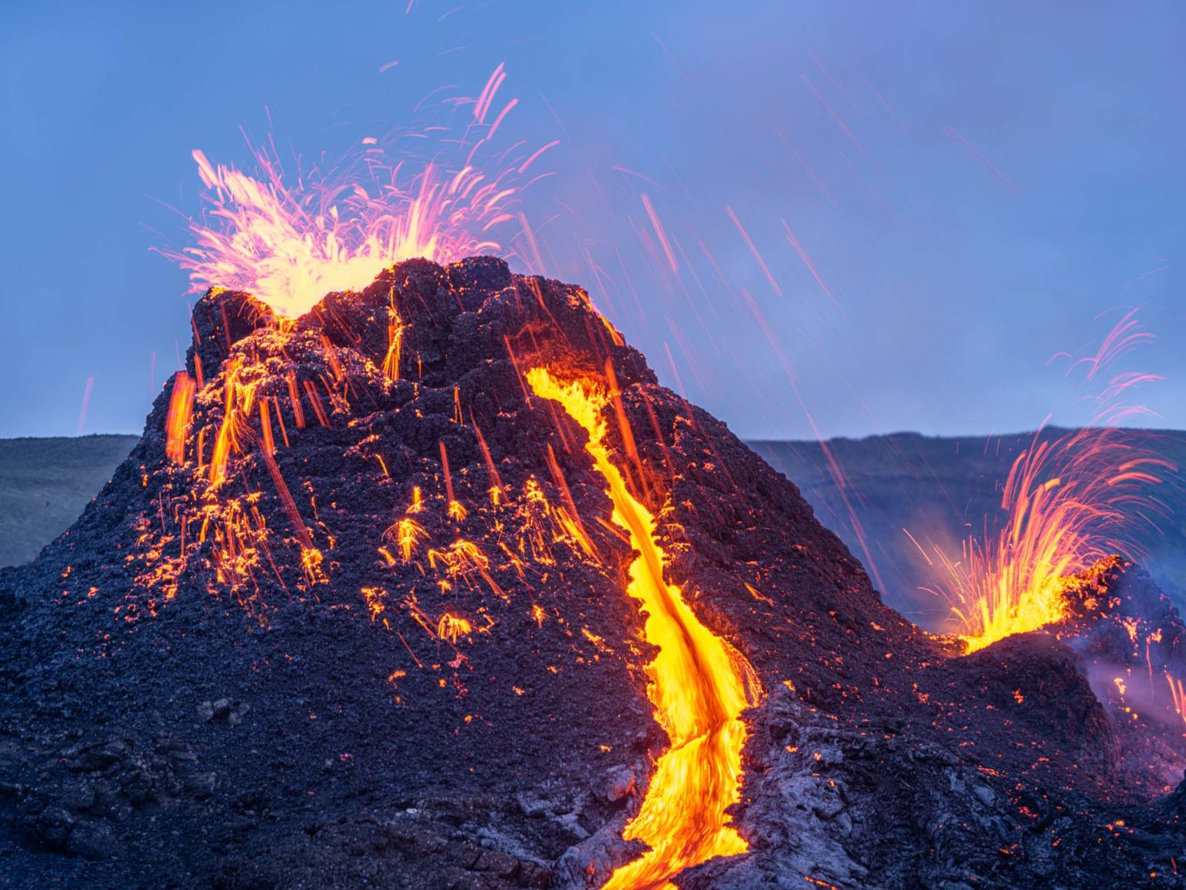
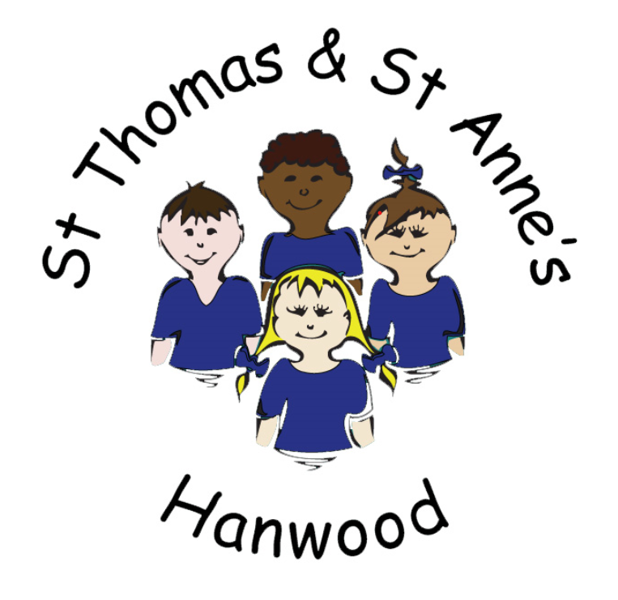
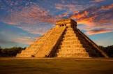
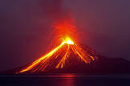
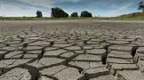
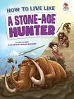
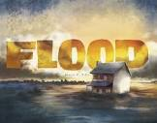
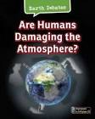
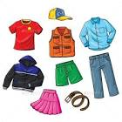
Oak Class
Spring Term 2022
Science:
Evolution and Inheritance
Recognising that living things have changed over time, through adaptation, evolution, inheritance and natural selection.
Properties and Changes of Materials
Group materials based on their properties and investigate how to dissolve and separate materials into reversable and irreversible changes.
History
The Maya
Builders
and growers: Identifying and exploring Maya settlements, food and farming.
Clues from the past: Understand Maya cultures, pastimes and artefacts.
Geography
Natural Disasters
What is the impact of natural disasters on physical processes?
What are the implications to the environment?
PSHE
Keeping Myself Safe: Keeping safe online, discussing legal drugs and decision-making skills.
Rights and Responsibilities: Decisions about lending, borrowing and spending and rights and responsibilities of my health.
As readers, our children will use the following texts to support and enhance their learning:
Fiction: ‘Flood’ by Alvaro F Villa, ‘Twitch’ by M. G. Leonard and ‘Letters from the Lighthouse’ by Emma Carroll.
Non-Fiction: ‘How To Live Like A Stone-Age Hunter’ by Anita Ganeri and ‘Are Humans Damaging the Atmosphere?’ by Catherine Chambers.
Poetry: ‘Cloud Busting’ by Malorie Blackman.
Music:
Exploring lyrics and melody
Exploring Blues music.
Exploring sound sources
Exploring loops and sounds of the future.
Maths:
Fractions, decimals and percentages: Ordering, comparing and finding the equivalents of each and rounding, adding, subtracting, multiplying and dividing decimals with the same and a different number of decimal places.
Measurements: Converting between different units of metric measure, as well as understanding equivalences between metric and imperial units and measures. Finding the perimeter and area of different shapes.
Statistics: Read and interpret tables in order to use the data when drawing line graphs and pie charts.
Ratio (Y6): Use ratio language in order to calculate the ratio, before recognising proportionality in context (for example in recipes).
Algebra (Y6): Using simple formulae to solve algebraic equations.
RE:
Christianity: Why do Christians believe Jesus was the Messiah?
Judaism: Why is the Torah so important to Jewish people?
Key events:
Arthog
STEM afternoon from Mary Webb
Swimming every Tuesday for Y5 and some Y6
PE and Sport
Swimming (Tuesdays)
Gymnastics
Outdoor Learning Equipment
Our children will use the texts and the links to the curriculum to develop their skills as writers of:
Narrative texts – Develop characters and settings.
Poetry – Free Verse, Haikus and Limericks.
Explanation texts – List and explain the ways in which humans are damaging the atmosphere.
Grammar and Punctuation - Modal verbs, relative clauses, using commas to mark clauses, expanded noun phrases, parenthesis, semi-colons, colons and dashes and active and passive voice.
Art and Design
Art of Anatomy
Sketch wireframes then create life-like sculptures of a human. Research the work of the artists Leonardo Da Vinci and Ancient Greek Sculptors.
Design Technology
Food
Master the practical skills of the culture and seasonality of food.
Languages:
Je m’habille: Learning clothes and describing their colour and size.
Computing
Programming – Variables in Games. Exploring variables when designing and coding a game.
Data and Information – Introduction to Spreadsheets. Answering questions by using spreadsheets to organise and calculate data.

